Slide 1
YACHI Map
Project Description
408850435 盧佳馨
408850260 楊思妤
408850112 劉姿妤

Slide 2
What we think
In Yilan,we always see tourists everywhere during weekend,and sometimes they asks us for what's good to eat, where's good to go, etc. Since that, we come up with the idea that how about we make a simple website for them to search for food.In this website, we focus on Jiaoxi Night Market. And the website provide information such as the whole map of Jiaoxi Night Market, the menu of each stall, and the basic introduction of the stall.

Slide 3
Introduction
Start
移動至
All MAP的頁面
點選All MAP
進入首頁
搜尋
關鍵字（攤位名稱或食物/飲料）
左側選單
A
C
移動至搜尋結果（以MAP呈現）
B
宜蘭必點
台灣必吃
好玩的攤
好喝的飲料
“點”亮你的“心”
B
B
B
B
B

Slide 4
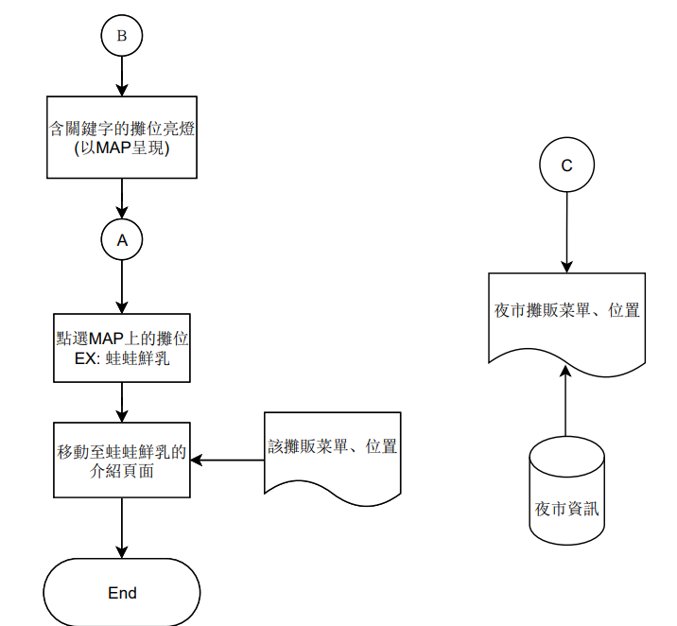
Introduction
B
含關鍵字的攤位亮燈（以MAP呈現）
C
A
夜市攤販菜單、位置
點選MAP上的攤位
EX:蛙蛙鮮乳
夜市資訊
移動至蛙蛙鮮乳的介紹頁面
該攤販菜單、位置
End

Slide 5
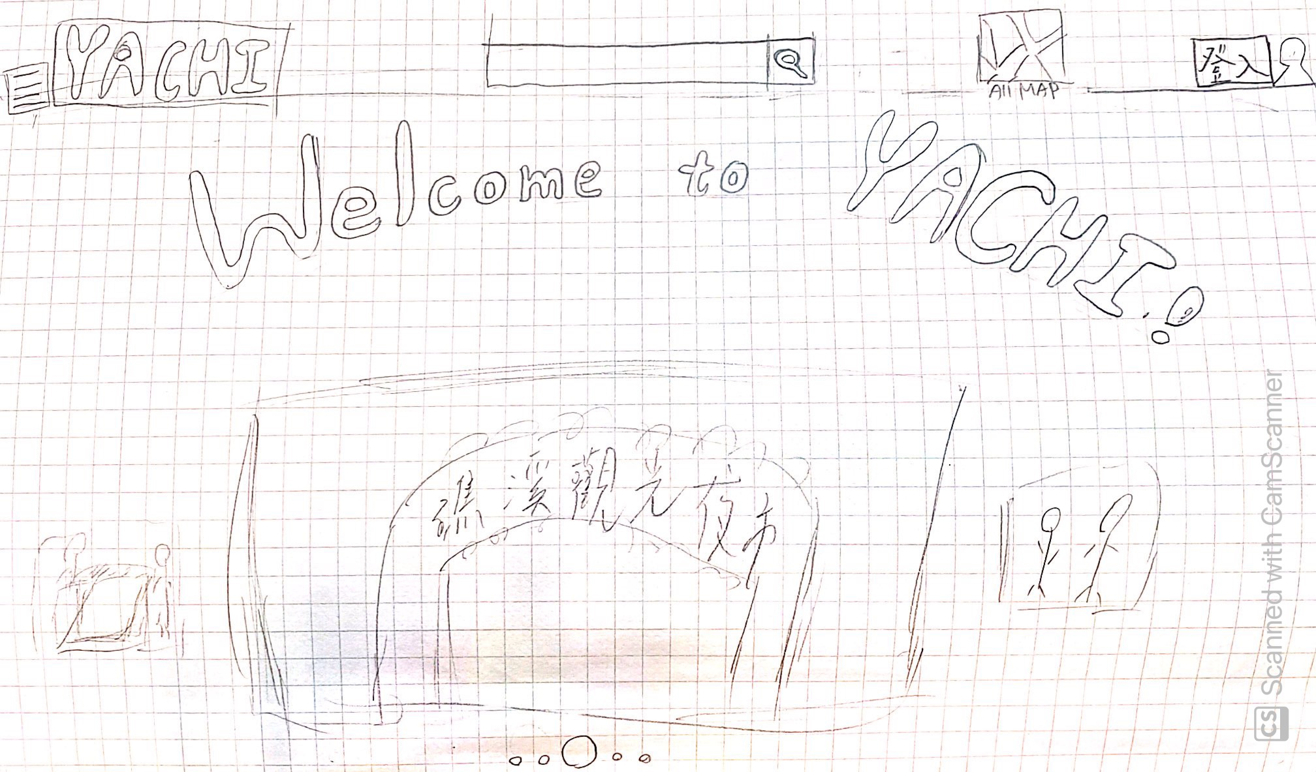
Home Page

Slide 6
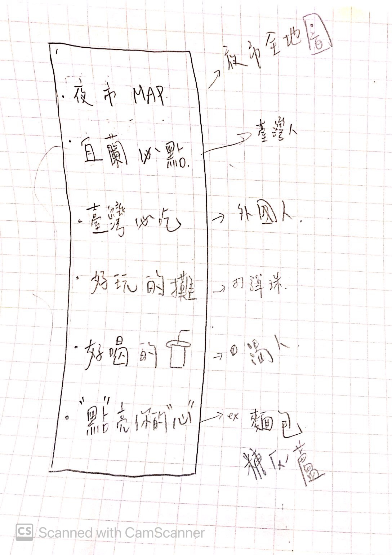
List
(click the menu icon button next to YACHI on the homepage and it will come out)

Slide 7
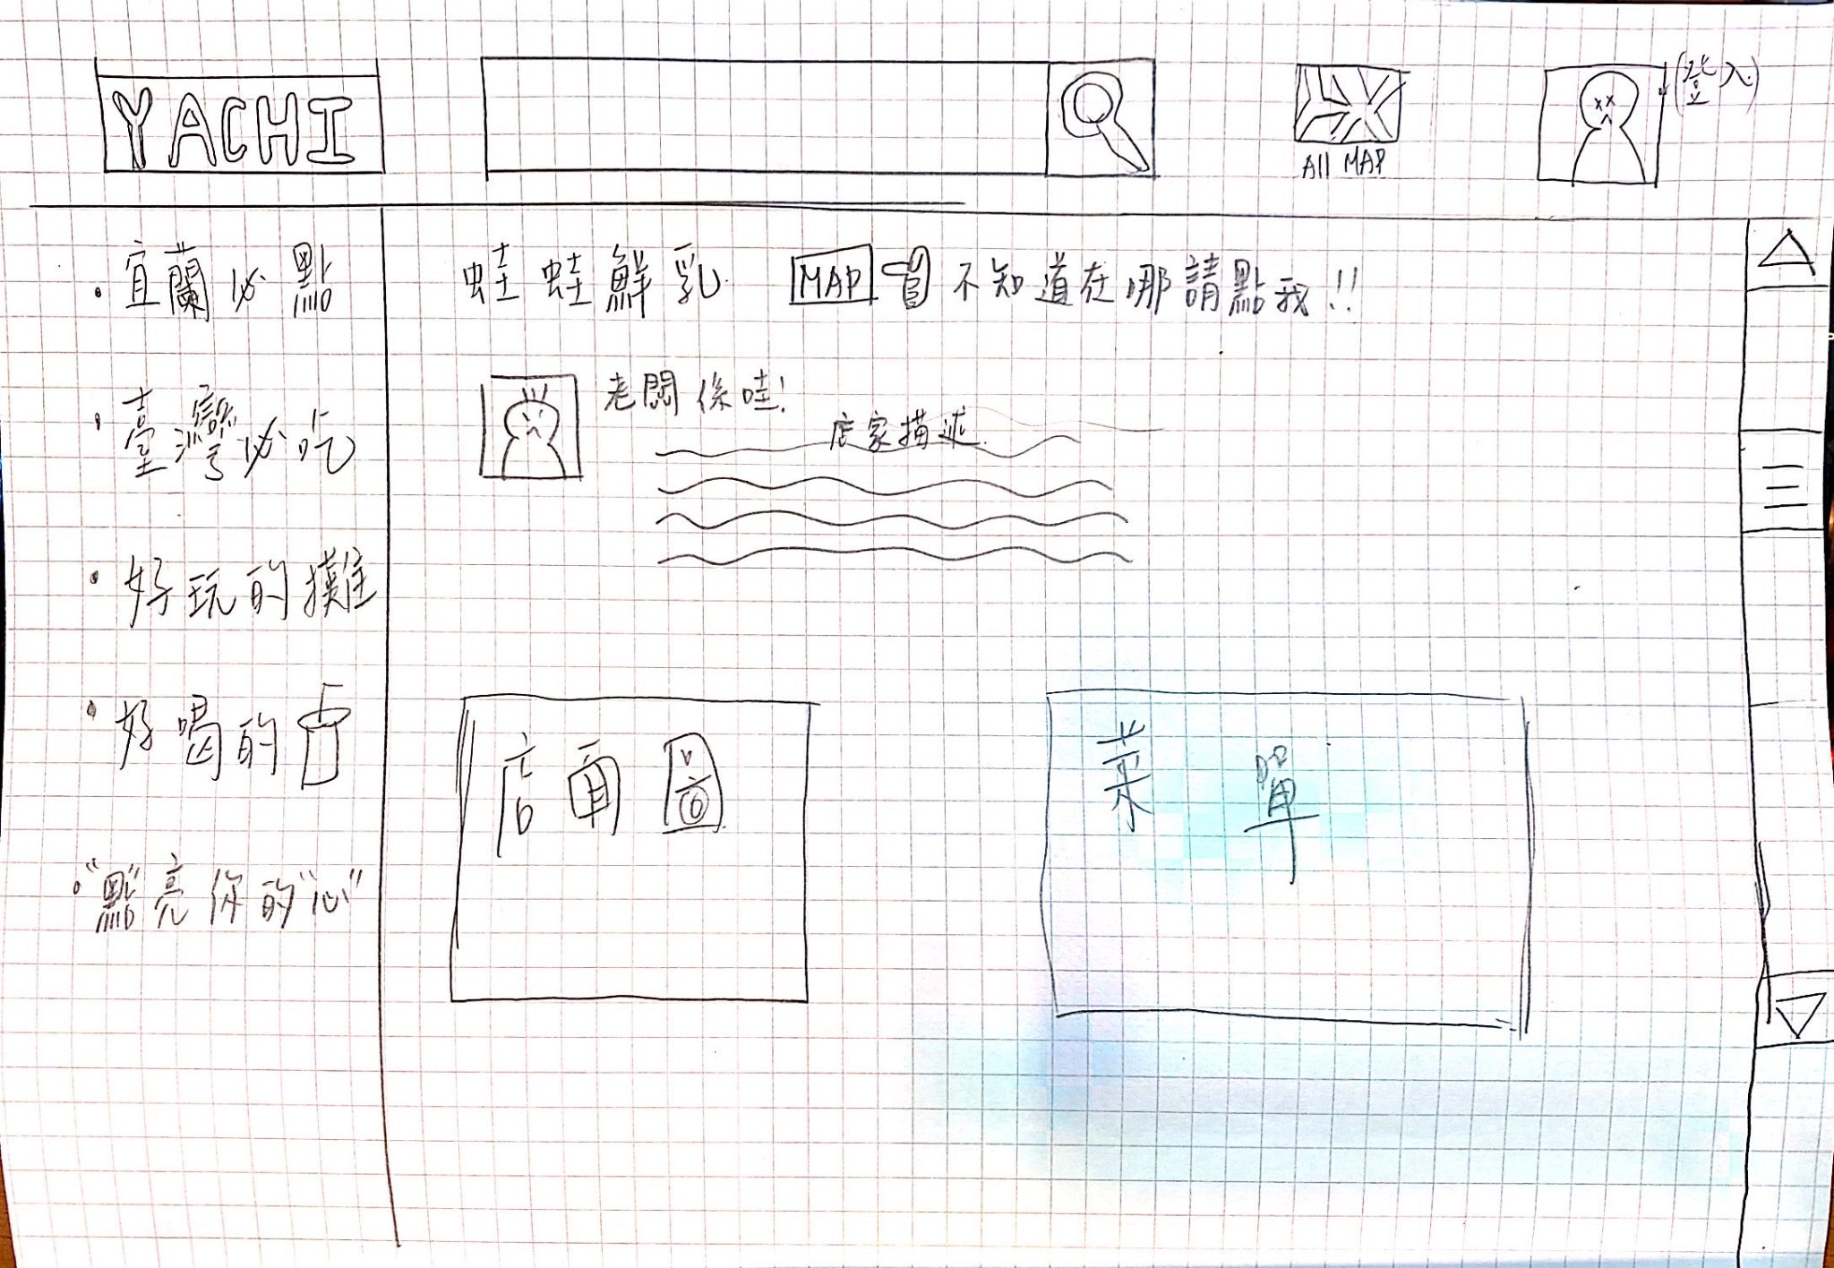
Vendor profile

Slide 8
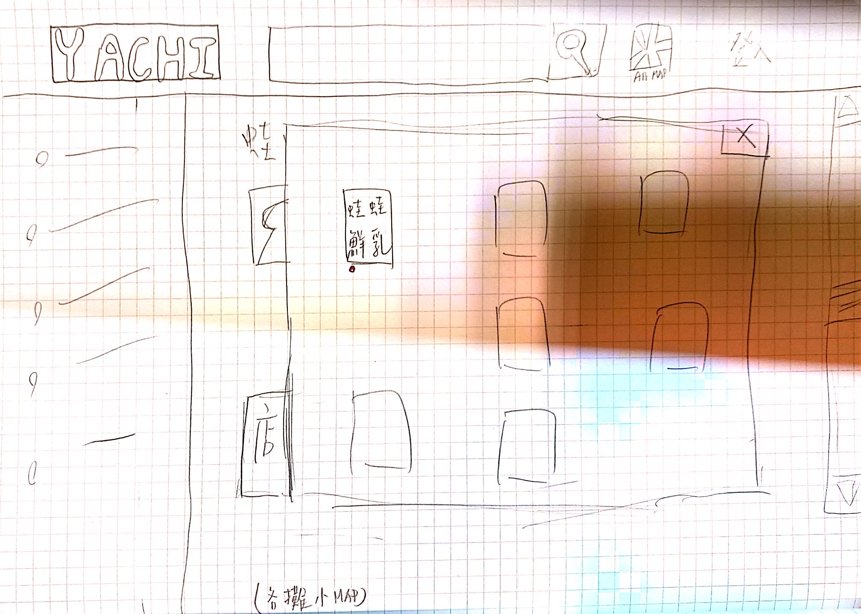
Small map of each stall
(click on the MAP button in the vendor profile and it will run out)

Slide 9
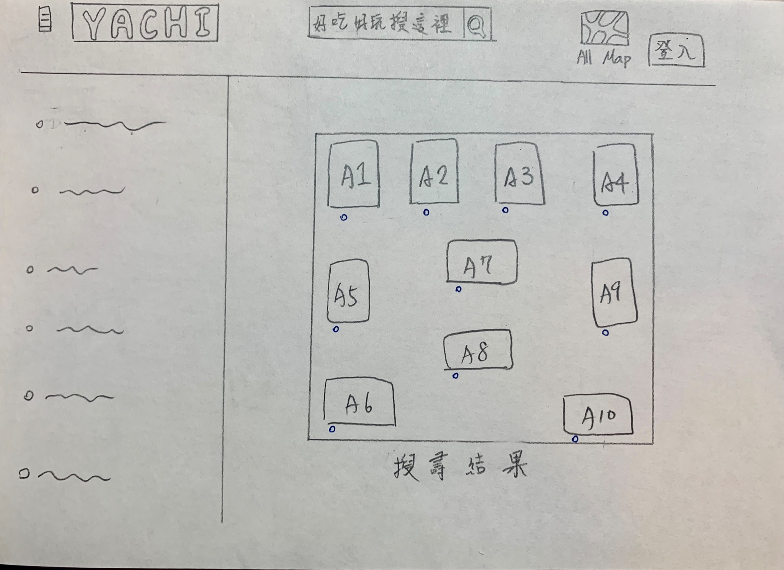
Search results
(the booths that matching the search keywords will be lit)

Slide 10
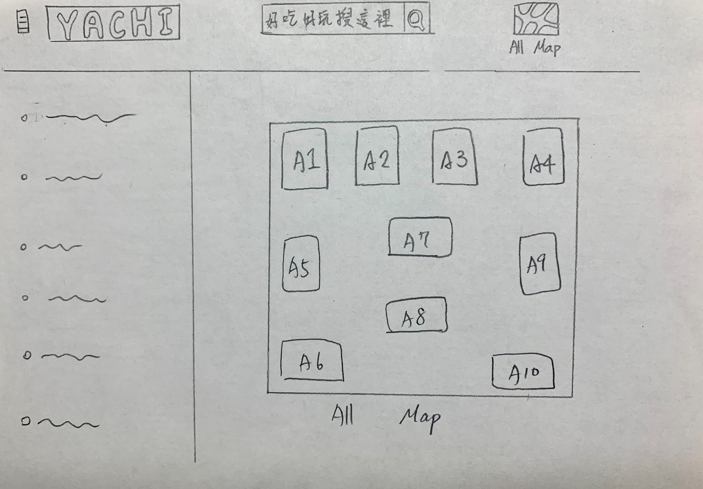
Full map (click the booth to view detailed information)

Slide 11
Diagram
造訪文章網站
顯示目標的html
瀏覽器
顯示頁面
回傳html
Server
Controller
傳入資料
連接sql、存取DB
View
Model

Slide 12
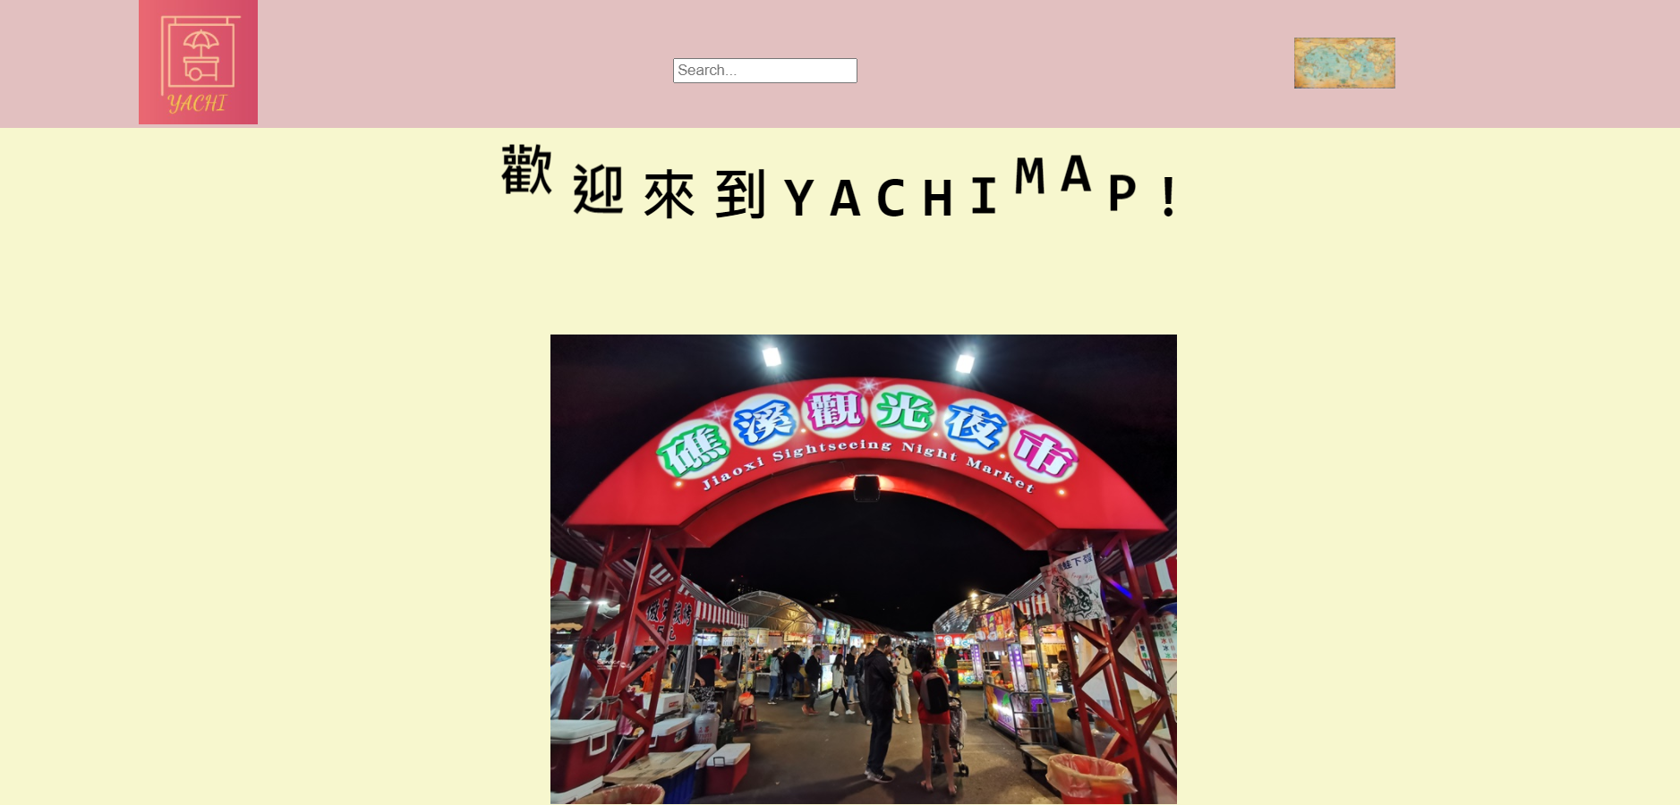
Home Page

Slide 13
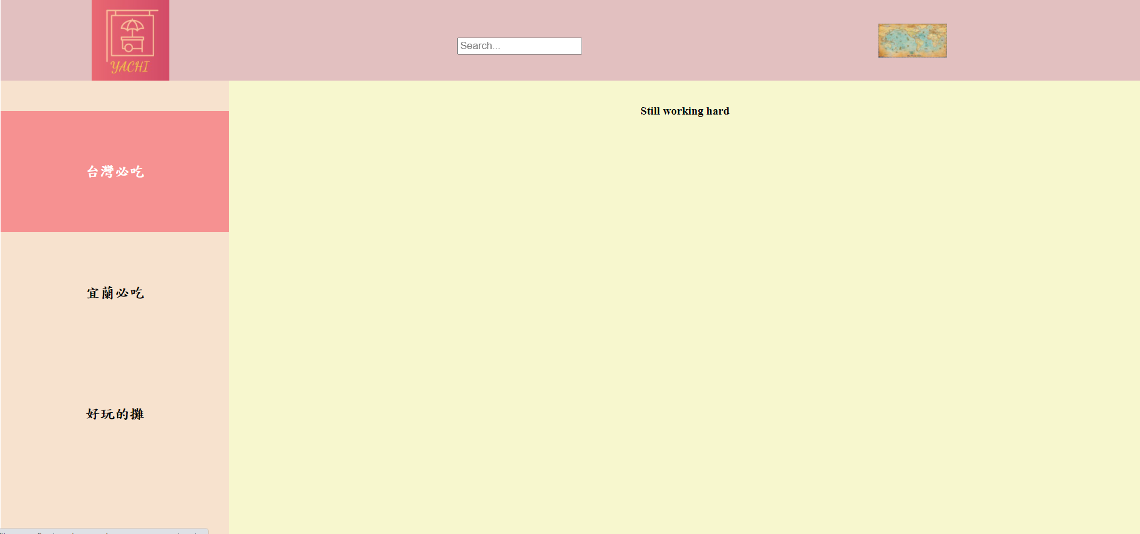
Home Page

Slide 14
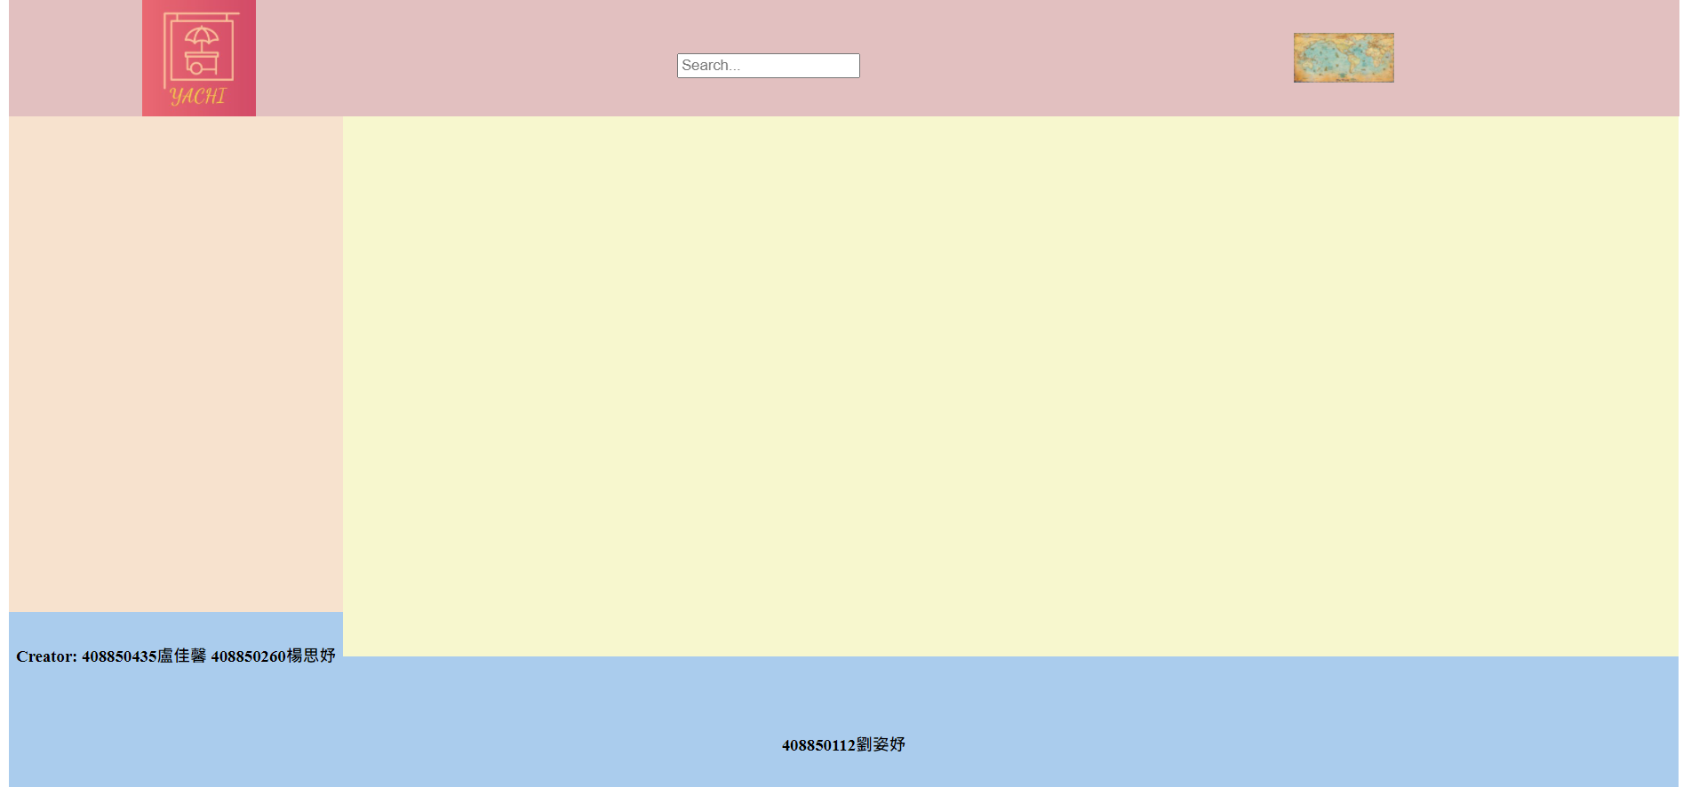
Home Page

Slide 15
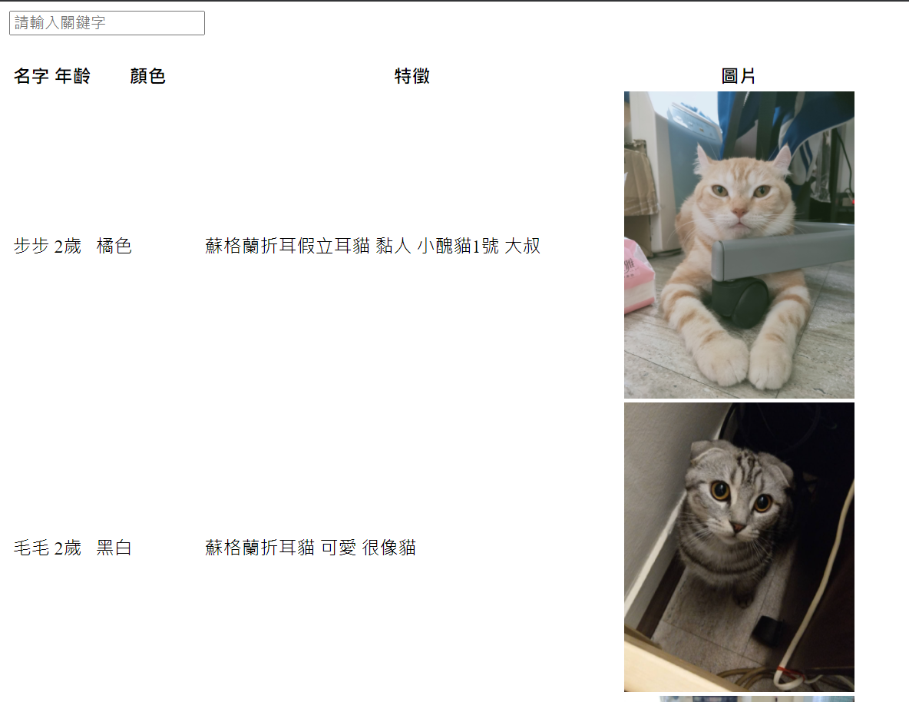
Search Engine

Slide 16
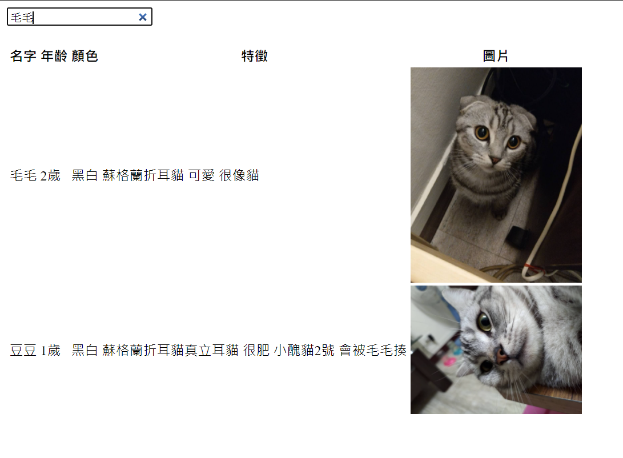
Search Engine

Slide 17
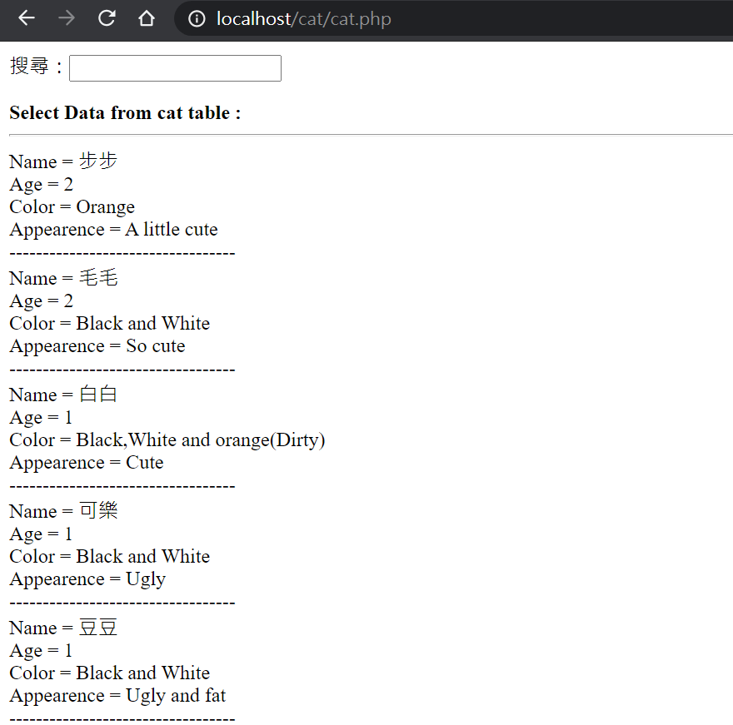
Search Engine

Slide 18
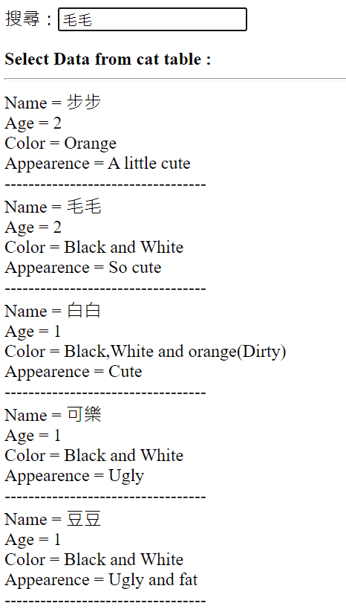
Search Engine

Slide 19
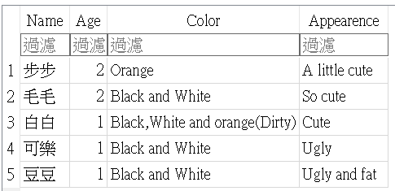
Database

Slide 20
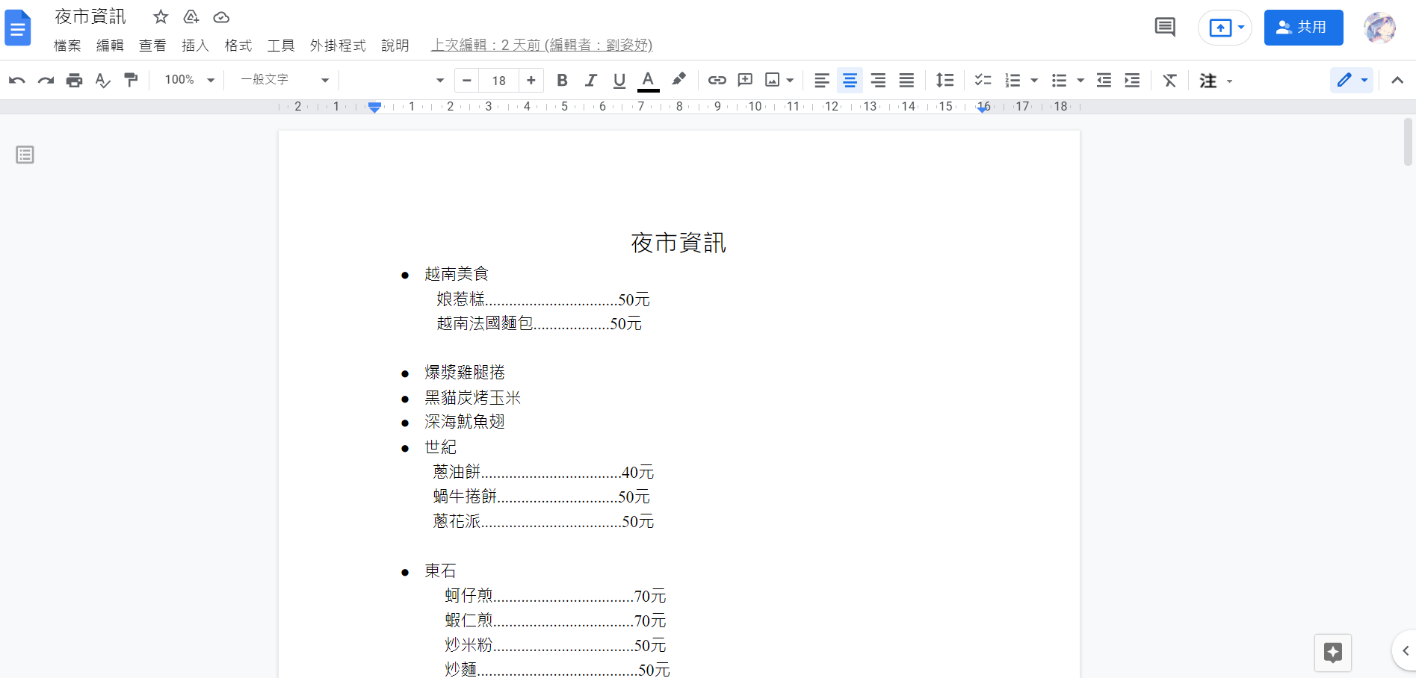
Data
https://docs.google.com/document/d/1pUTO3WFSzwhsJGJYWv1SU3Qv9PiMLIxLydTMySdE-kc/edit

Slide 21
repository
https://github.com/y1346025/YACHI

Slide 22
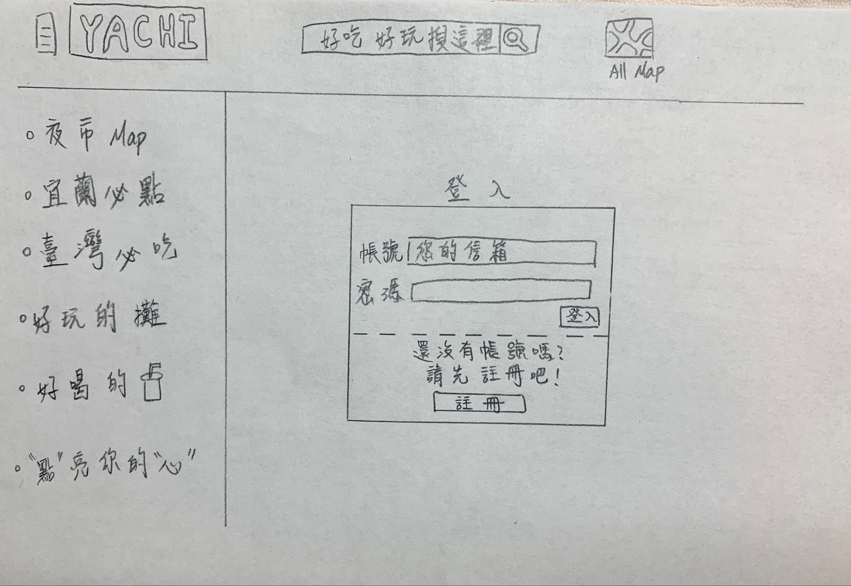
Login

Slide 23
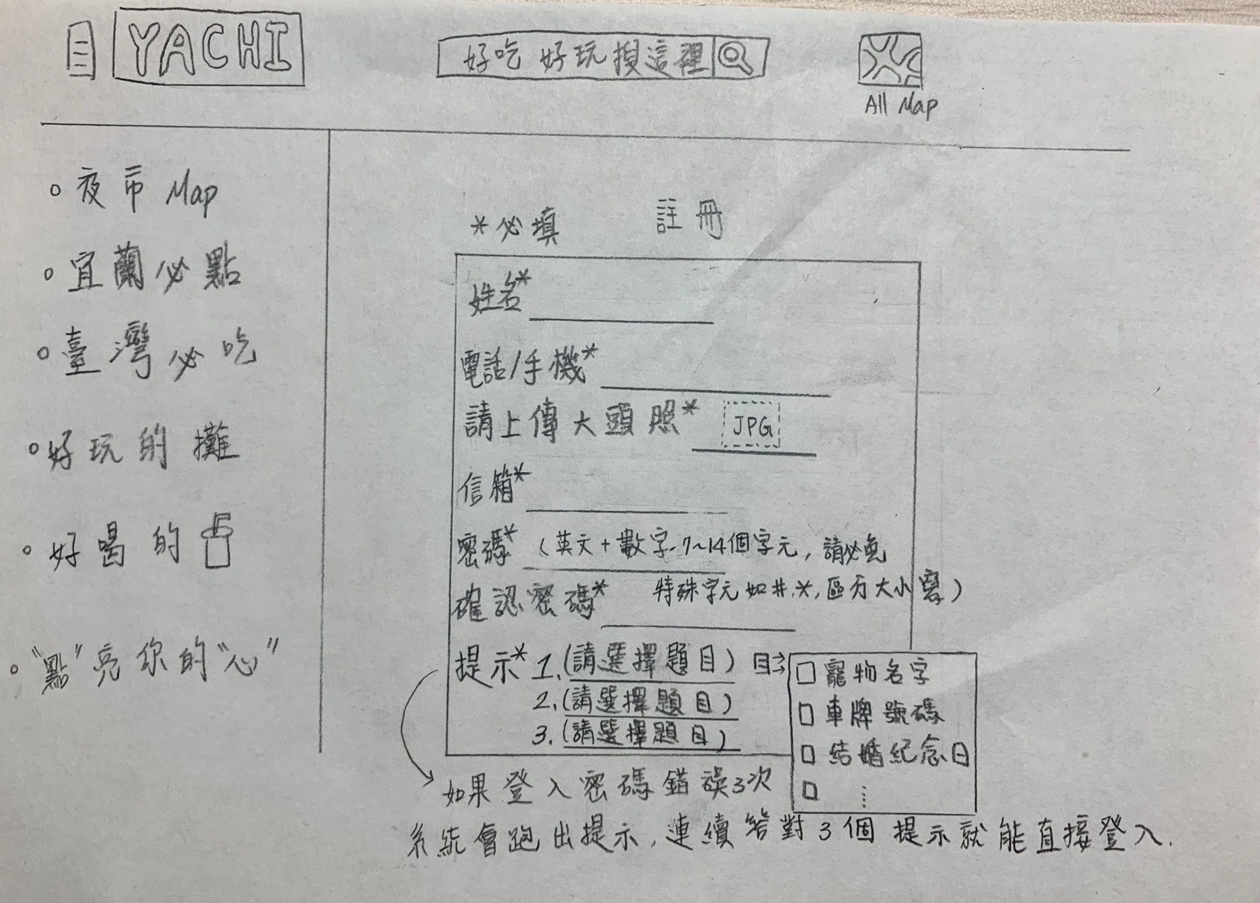
Register

